Slide 1
Unit- 5
Rapid Prototyping

Slide 2
Content
Classification of RPT systems,
Process chain,
3D modelling,
Data conversion,
Checking-building- postprocessing,
Stereolithography (STL)-process, principle,
CAD for RPT,
Creation of STL file from 3D solid models

Slide 3
Additive Manufacturing
Additive manufacturing (AM), also known as 3D printing, is a process in which a three-dimensional object is built from a computer-aided design (CAD) model, usually by successively adding materials in a layer-by-layer fashion.

Slide 4
Stereolithography (SLA)

Slide 5
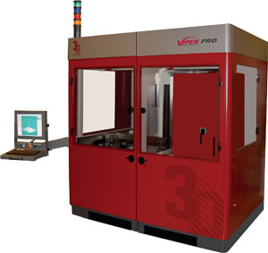
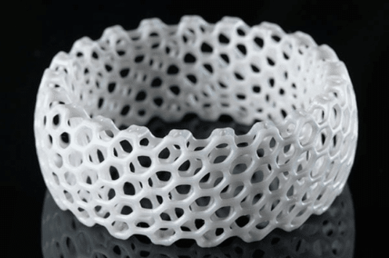
Stereolithography (SLA)
Stereolithography is a common rapid manufacturing/ rapid prototyping technology for producing parts with high accuracy and good surface finish,
A device that performs stereolithography is called an SLA or Stereolithography Apparatus,
Stereolithography is an additive fabrication process utilizing a vat of liquid UV-curable photopolymer "resin" and a UV laser to build parts a layer at a time,
On each layer, the laser beam traces a part cross-section pattern on the surface of the liquid resin.
https://www.youtube.com/watch?v=yW4EbCWaJHE&t=39s

Slide 6
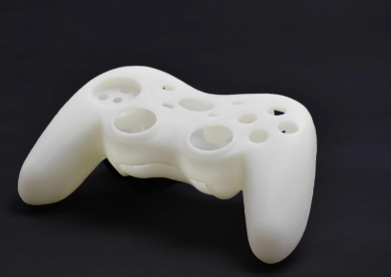
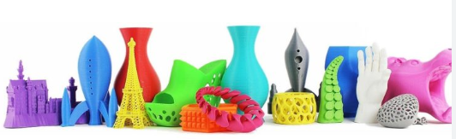
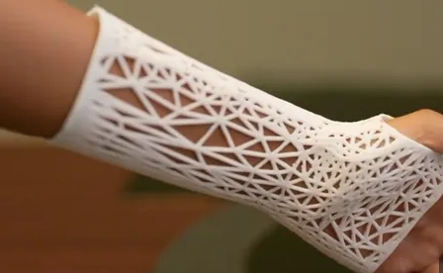
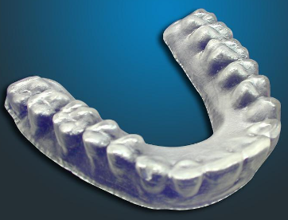
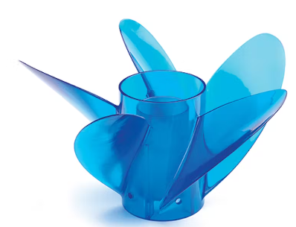
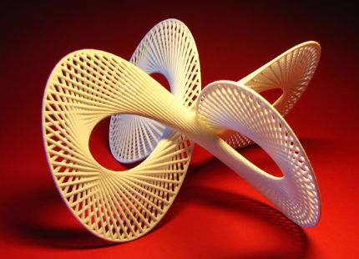
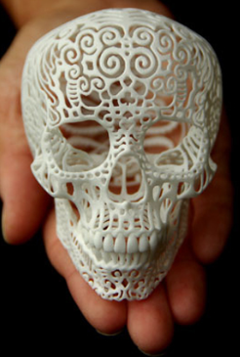
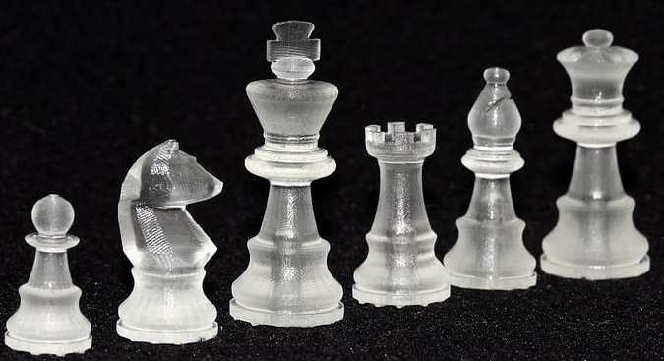
Few example products

Slide 7
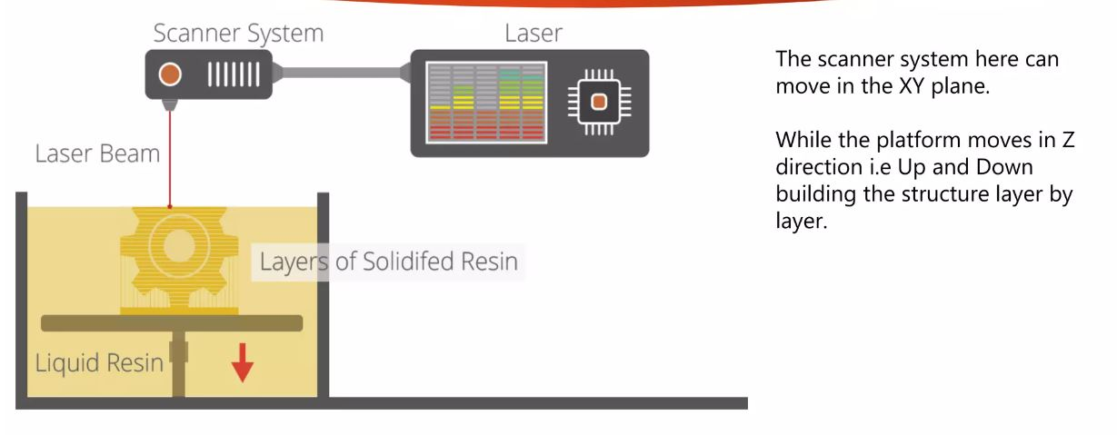
Stereo lithography Process Diagram

Slide 8
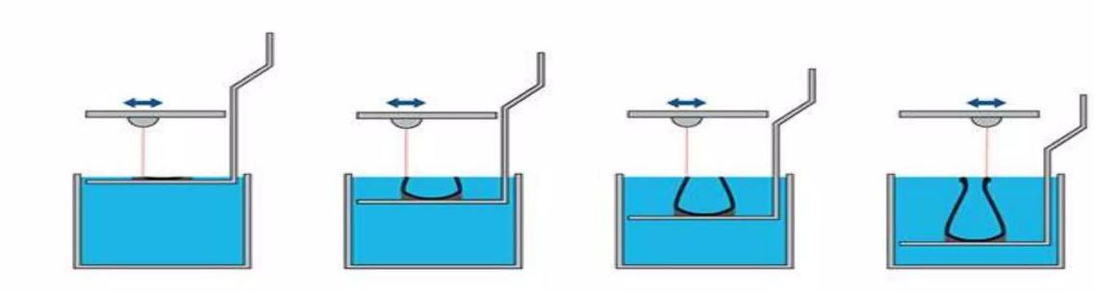
Stereo lithography Process Diagram

Slide 9
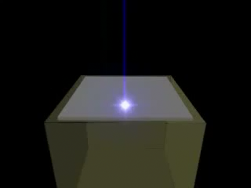
Process animation

Slide 10
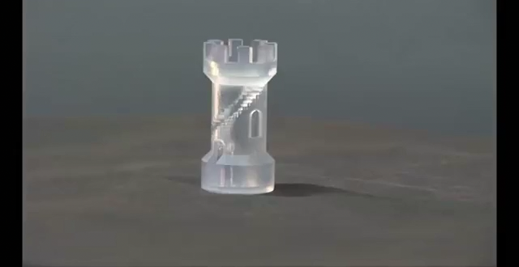
Process Video

Slide 11
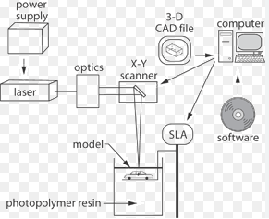
Stereo Lithography Schematic Diagram

Slide 12
Stereo lithography Highlight
The first RP technique and is still most widely used.
Inexpensive compared to other techniques.
Uses light-sensitive liquid polymer.
Requires post-curing since laser is not of high enough power to complete.
Long-term curing.
Parts are quite brittle and have a tacky surface.
Support structures are typically required.
Process is simple: There are no milling or masking steps required.
Uncured material can be toxic.

Slide 13
Technical details of the Process
The starting materials are liquid monomers
Each layer is 0.076 mm to 0.50 mm (0.003 in to 0.020 in.) thick
Thinner layers provide better resolution and more intricate shapes; but processing time is longer
Laser scan speeds typically 500 to 2500 mm/s

Slide 14
Process Overview
Stereolithography is one of the more commonly used rapid manufacturing and rapid prototyping technologies.
It is considered to provide high accuracy and good surface finish.
It involves building plastic parts a layer at a time by tracing a laser beam on the surface of a vat of liquid photopolymer.
The photopolymer is solidified by the laser light.

Slide 15
Process Overview
Once one layer is completely traced, it is lowered a small distance into the liquid and a subsequent layer is traced, adhering to the previous layer.
After many such layers are traced, a complete 3D model is formed.
Some specific technologies require further curing of the polymer in an oven."

Slide 16
Process Details – Step by step
A moveable table, or elevator, initially is placed at a position just below the surface of a vat filled with liquid photopolymer resin.
This material has the property that when light of the correct color strikes it, it turns from a liquid to a solid.
The most common photopolymer materials used require an ultraviolet light.
The system is sealed to prevent the escape of fumes from the resin.

Slide 17
Process Details – Step by step
A laser beam is moved over the surface of the liquid photopolymer to trace the geometry of the cross-section of the object.
This causes the liquid to harden in areas where the laser strikes.
The laser beam is moved in the X-Y directions by a scanner system.
Stepper motors are fast and highly controllable motors which drive mirrors and are guided by information from the CAD data.

Slide 18
Process Details – Step by step
Some geometries of objects have overhangs or undercuts. These must be supported during the fabrication process.
The support structures are either manually or automatically designed.
Upon completion of the fabrication process, the object is elevated from the vat and allowed to drain.
Excess resin is swabbed manually from the surfaces. The object is often given a final cure by bathing it in intense light in a box resembling an oven called a Post-Curing Apparatus (PCA).

Slide 19
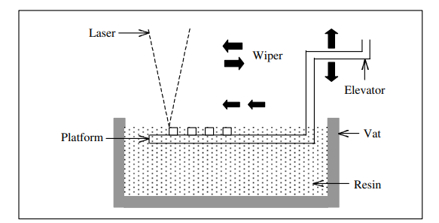
Process

Slide 20
Advantages
Round the clock operation. The SLA can be used continuously and work round the clock.
Good user support. The computerized process serves as a good user support.
Build volumes. The different SLA machines have build volumes ranging from small to large to suit the needs of different users.
Good accuracy. The SLA has good accuracy and can be used or many application areas.
Surface finish. The SLA can obtain one of the best surface finishes amongst RP technologies.

Slide 21
Disadvantages
Requires support structures. Structures that have overhangs and undercuts must have supports that are designed and fabricated together with the main structure.
Requires post-processing. Post-processing includes removal of supports and other unwanted materials, which is tedious, time consuming and can damage the model.
Requires post-curing. Post-curing may be needed to cure the object completely and ensure the integrity of the structure

Slide 22
Types of RP Systems
Prototyping Technologies | Base Materials
Selective laser sintering (SLS) | Thermoplastics, metals powders
Fused Deposition Modeling (FDM) | Thermoplastics
Stereolithography (SLA) | photopolymer
Laminated Object Manufacturing (LOM) | Paper
Electron Beam Melting (EBM) | Titanium alloys
3D Printing (3DP) | Various materials
Notes:
Selective laser sintering is an additive rapid manufacturing technique that uses a high power laser (for example, a carbon dioxide laser) to fuse small particles of plastic, metal, or ceramic powders into a mass representing a desired 3-dimensional object. The laser selectively fuses powdered material by scanning cross-sections generated from a 3-D digital description of the part (for example from a CAD file or scan data) on the surface of a powder bed. After each cross-section is scanned, the powder bed is lowered by one layer thickness, a new layer of material is applied on top, and the process is repeated until the part is completed.
Compared to other rapid manufacturing methods, SLS can produce parts from a relatively wide range of commercially available powder materials, including polymers (nylon, also glass-filled or with other fillers, and polystyrene), metals (steel, titanium, alloy mixtures, and composites) and green sand. The physical process can be full melting, partial melting, or liquid-phase sintering. And, depending on the material, up to 100% density can be achieved with material properties comparable to those from conventional manufacturing methods. In many cases large numbers of parts can be packed within the powder bed, allowing very high productivity.

Slide 23
Classification of RPT systems
RPT systems
Liquid Based
Powder Based
Solid Based

Slide 24
Liquid-Based Rapid Prototyping
Liquid-based RP systems have initial form of its material in liquid state. Through a process commonly known as curing, the liquid is converted to the solid state. The following RP systems fall into this category:
3D Systems' Stereolithography Apparatus (SLA)
Cubital's Solid Ground Curing (SGC)
Sony's Solid Creation System (SCS)
CMET’s Solid Object Ultraviolet-laser Printer (SOUP)
Autostrade’s E-Darts
Teijin Seiki’s Soliform System
Meiko's Rapid Prototyping System for the Jewelry Industry
Denken’s SLP
Mitsui's COLAMM
Fockele & Schwarze’s LMS
Light Sculpting
Rapid Freeze
Two Laser Beams
Microfabrication
Aaroflex

Slide 25
Solid Based
Solid-based RP systems are meant to encompass all forms of material in the solid state,
The solid form can include the shape in the form of a wire, a roll, laminates and pellets.
Cubic Technologies’ Laminated Object Manufacturing (LOM),
Stratasys’ Fused Deposition Modeling (FDM),
Kira Corporation’s Paper Lamination Technology (PLT),
3D Systems’ Multi-Jet Modeling System (MJM),
Solidscape’s ModelMaker and PatternMaster,
Beijing Yinhua’s Slicing Solid Manufacturing (SSM), Melted Extrusion Modeling (MEM) and Multi-Functional RPM Systems (M-RPM),
CAM-LEM’s CL 100,
Ennex Corporation’s Offset Fabbers

Slide 26
Powder Based
Powder is by-and-large in the solid state in the form of grains.
3D Systems’s Selective Laser Sintering (SLS),
EOS’s EOSINT Systems,
Z Corporation’s Three-Dimensional Printing (3DP),
Optomec’s Laser Engineered Net Shaping (LENS),
Soligen’s Direct Shell Production Casting (DSPC),
Fraunhofer’s Multiphase Jet Solidification (MJS),
Acram’s Electron Beam Melting (EBM),
Aeromet Corporation’s Lasform Technology,
Precision Optical Manufacturing’s Direct Metal Deposition (DMDTM),
Generis’ RP Systems (GS),
Therics Inc.’s Theriform Technology,
Extrude Hone’s Prometal TM 3D Printing Process

Slide 27
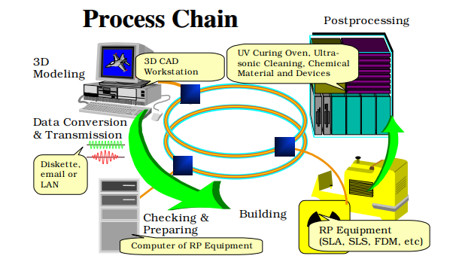
Process Chain

Slide 28
PROCESS CHAIN
There are a total of five steps in the chain and these are
3D modeling,
data conversion and transmission,
checking and preparing,
building
and post-processing.
Depending on the quality of the model and part in Steps 3 and 5 respectively, the process may be iterated until a satisfactory model or part is achieved.

Slide 29
3D MODELLING
Advanced 3D CAD modeling is a general prerequisite in RP processes
It also involved FEM analysis, detail design and drafting, planning for manufacturing,
Special care to be taken for orientation of part, need for supports, difficult-to-build part structure such as thin walls, small slots or holes and overhanging elements.
Under-specifying parameters to the RP systems, resulting in poor performance and non-optimal utilization of the system.

Slide 30
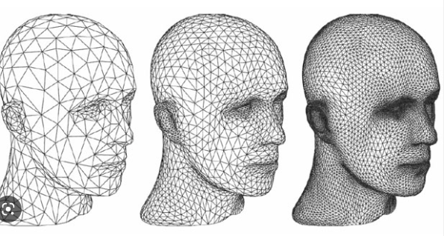
DATA CONVERSION AND TRANSMISSION
The solid or surface model to be built is next converted into a format dubbed the STL file format.
The STL file format approximates the surfaces of the model using tiny triangles.
Highly curved surfaces must employ many more triangles, which mean that STL files for curved parts can be very large,

Slide 31
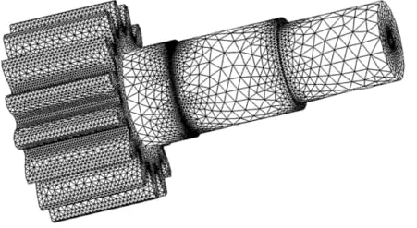
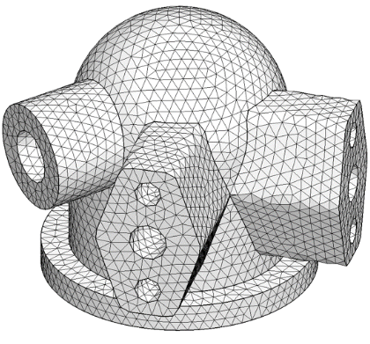
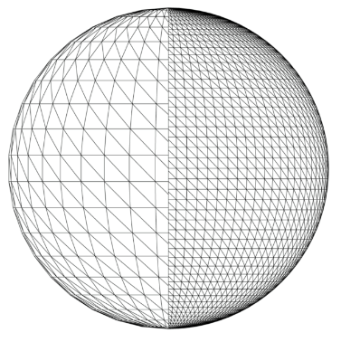
STL FILE

Slide 32
DATA CONVERSION AND TRANSMISSION
Almost, if not all, major CAD/CAM vendors supply the CAD-STL interface.
This conversion step is probably the simplest and shortest of the entire process chain.
For a highly complex model coupled with an extremely low performance workstation or PC, the conversion can take several hours.
Otherwise, the conversion to STL file should take only several minutes.
Where necessary, supports are also converted to a separate STL file.

Slide 33
CHECKING AND PREPARING
This process of manual repair is very tedious and time consuming,
The CAD model errors are corrected by human operators assisted by specialized software such as MAGICS,
Once the STL files are verified to be error-free, the system slices the model into cross-sections,
Each output file is sliced into cross-sections, between 0.12 mm (minimum) to 0.50 mm (maximum) in thickness,
The model is sliced into the thinnest layer as they have to be very accurate,
The supports can be created using coarser settings

Slide 34
BUILDING
For most RP systems, this step is fully automated,
Thus, it is usual for operators to leave the machine on to build a part overnight,
The building process may take up to several hours to build depending on the size and number of parts required.

Slide 35
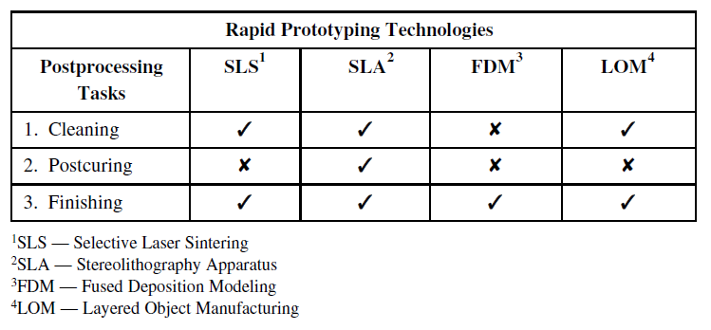
POSTPROCESSING
The final task in the process chain is the postprocessing task.
At this stage, generally some manual operations are necessary.
As a result, the danger of damaging a part is particularly high.
Operator for this last process step has a high responsibility for the successful process realization.

Slide 36
Few Basic Terms
Photopolymerization: Polymerization is the process of linking small molecules (known as monomers) into chain-like larger molecules (known as polymers),
When the chain-like polymers are linked further to one another, a cross-linked polymer is said to be formed,
Photopolymerization is polymerization initiated by a photochemical process, whereby the starting point is usually the induction of energy from the radiation source.
Photopolymers: The term photopolymer refers to a class of light-sensitive resins that solidify when exposed to ultraviolet (UV) light,
When the liquid photopolymer resin comes into contact with a UV light source - typically a lamp, laser, or projector - photoinitiators transform that light energy into chemical energy,
Then, oligomers or “binders” and monomers combine, harden, and form bonds that create the polymer structure,
Photopolymers are either thermoplastics, which melt at high temperature, thermosets, meaning they can’t be melted or reshaped once cured by heat.

Slide 37
Thanks

